Slide 1


Pharmaceutical Sales Prediction
Bharti Jagyasi

Slide 2

Agenda
*Introduction
*Prediction of store sales
*Serving predictions on a web interface
*Summary

Slide 3

Introduction
The finance team aims to predict sales across all stores in various cities, six weeks in advance.
Historically, sales forecasting relied on managerial experience and judgment. Your objective is to deliver an end-to-end predictive solution to help the finance team plan effectively

Slide 4
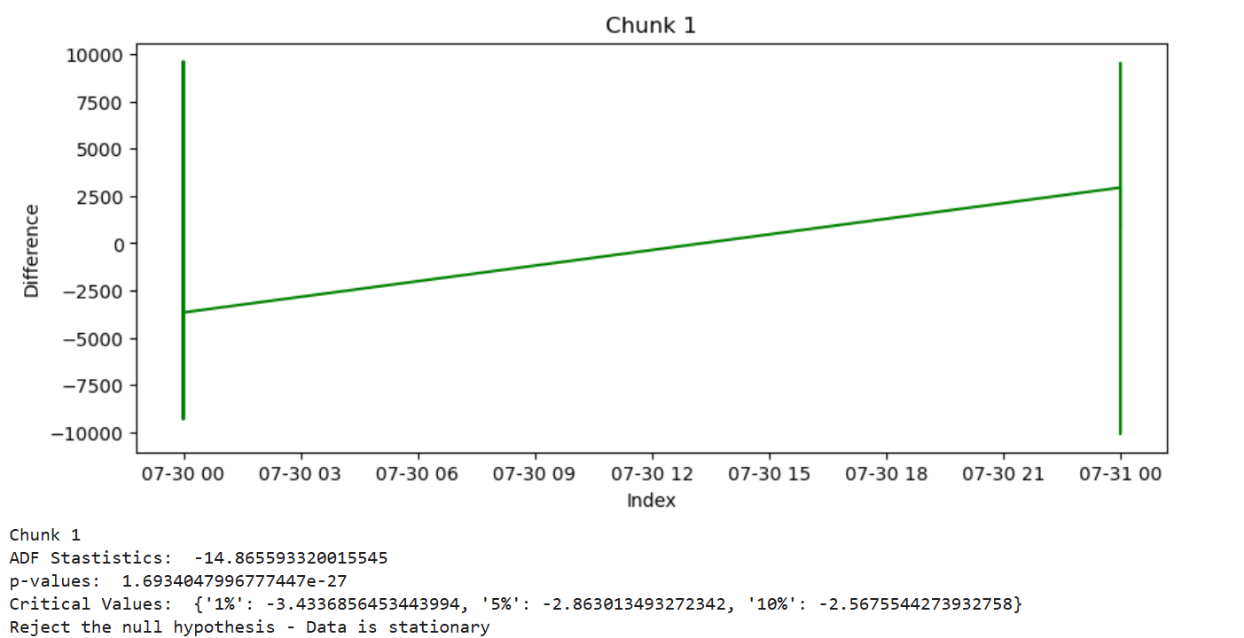
Predictions according to random forest

Slide 5
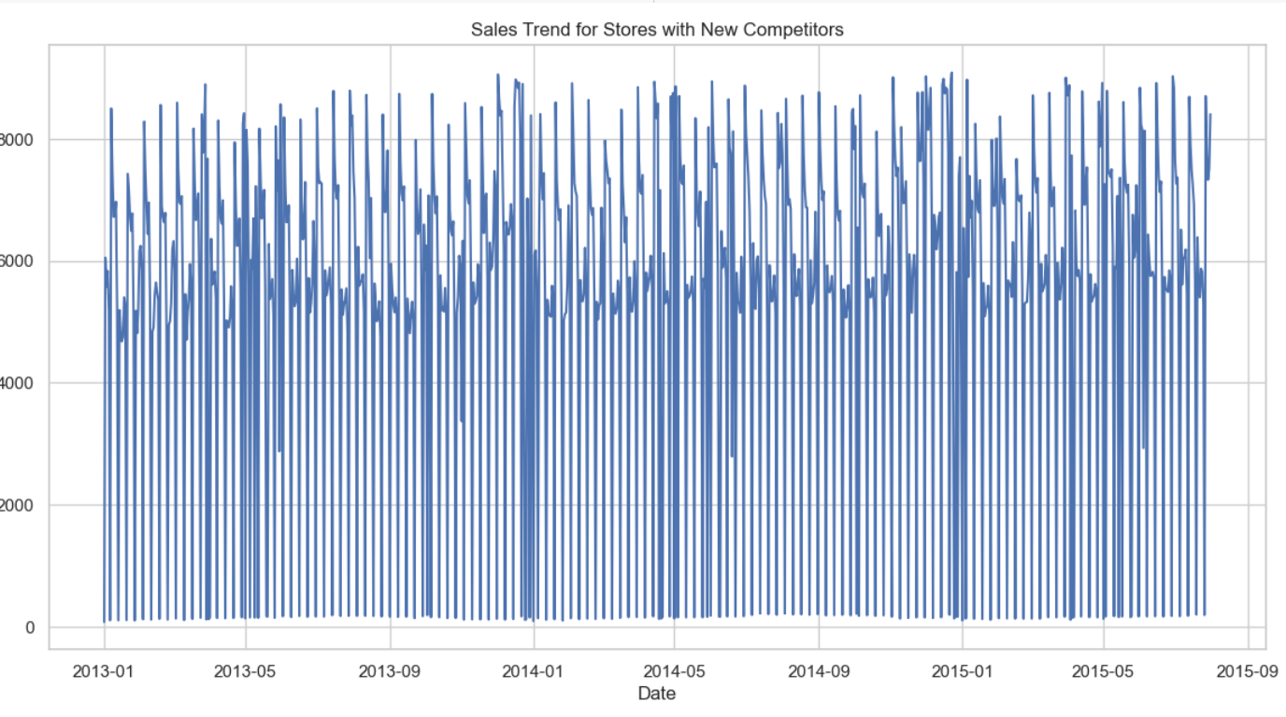
Sales Trend for Stores with New Competitors

Slide 6
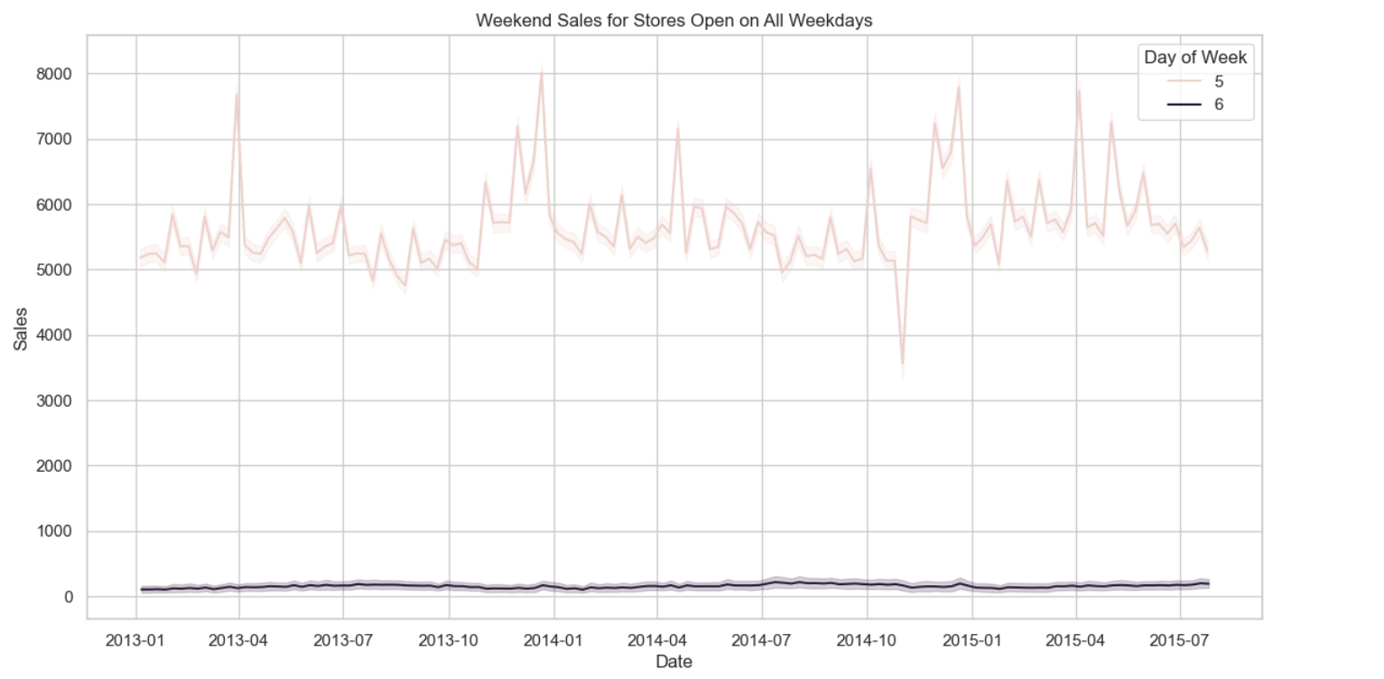
Day 5 (Friday) experiences much higher customer traffic and purchases compared to Day 6 (Saturday).

Slide 7
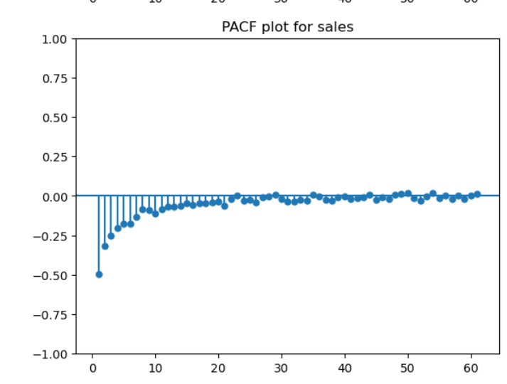
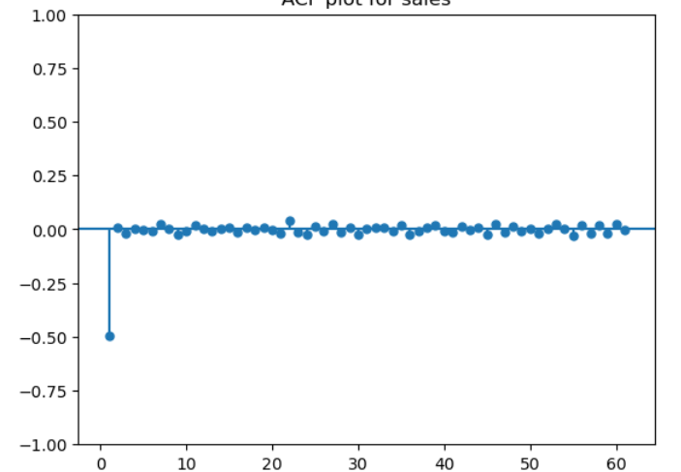
High Partial autocorrelation for legs of multiples of 7

Slide 8
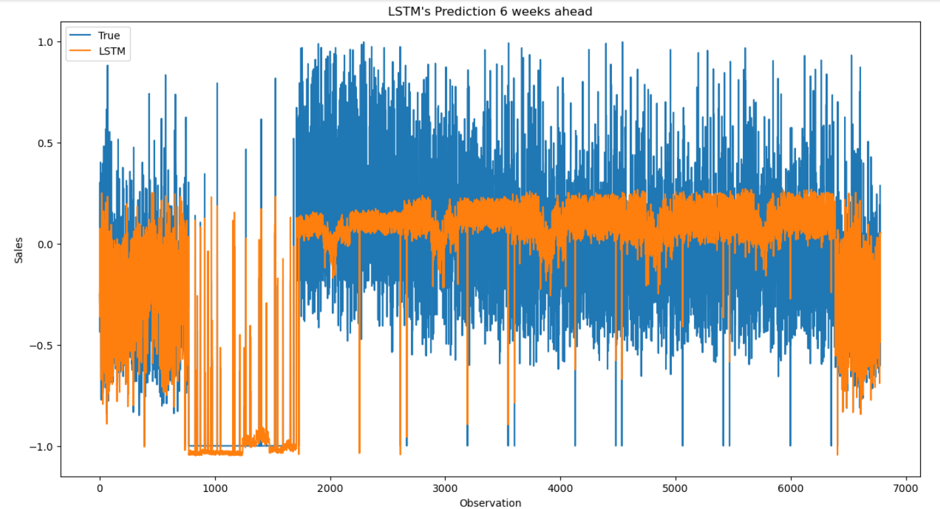
Neural Network seems to perform better that a LSTM network

Slide 9
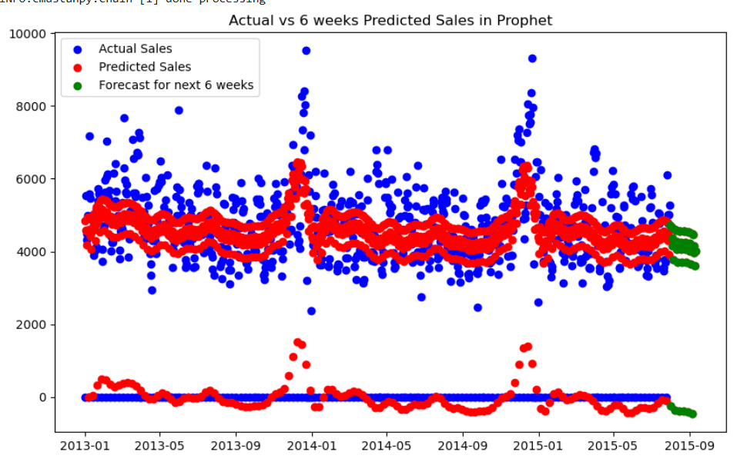
Actual and Predicted Sale in Prophet

Slide 10
Thank you

